Slide 1

WELCOME
CADETS

Slide 2
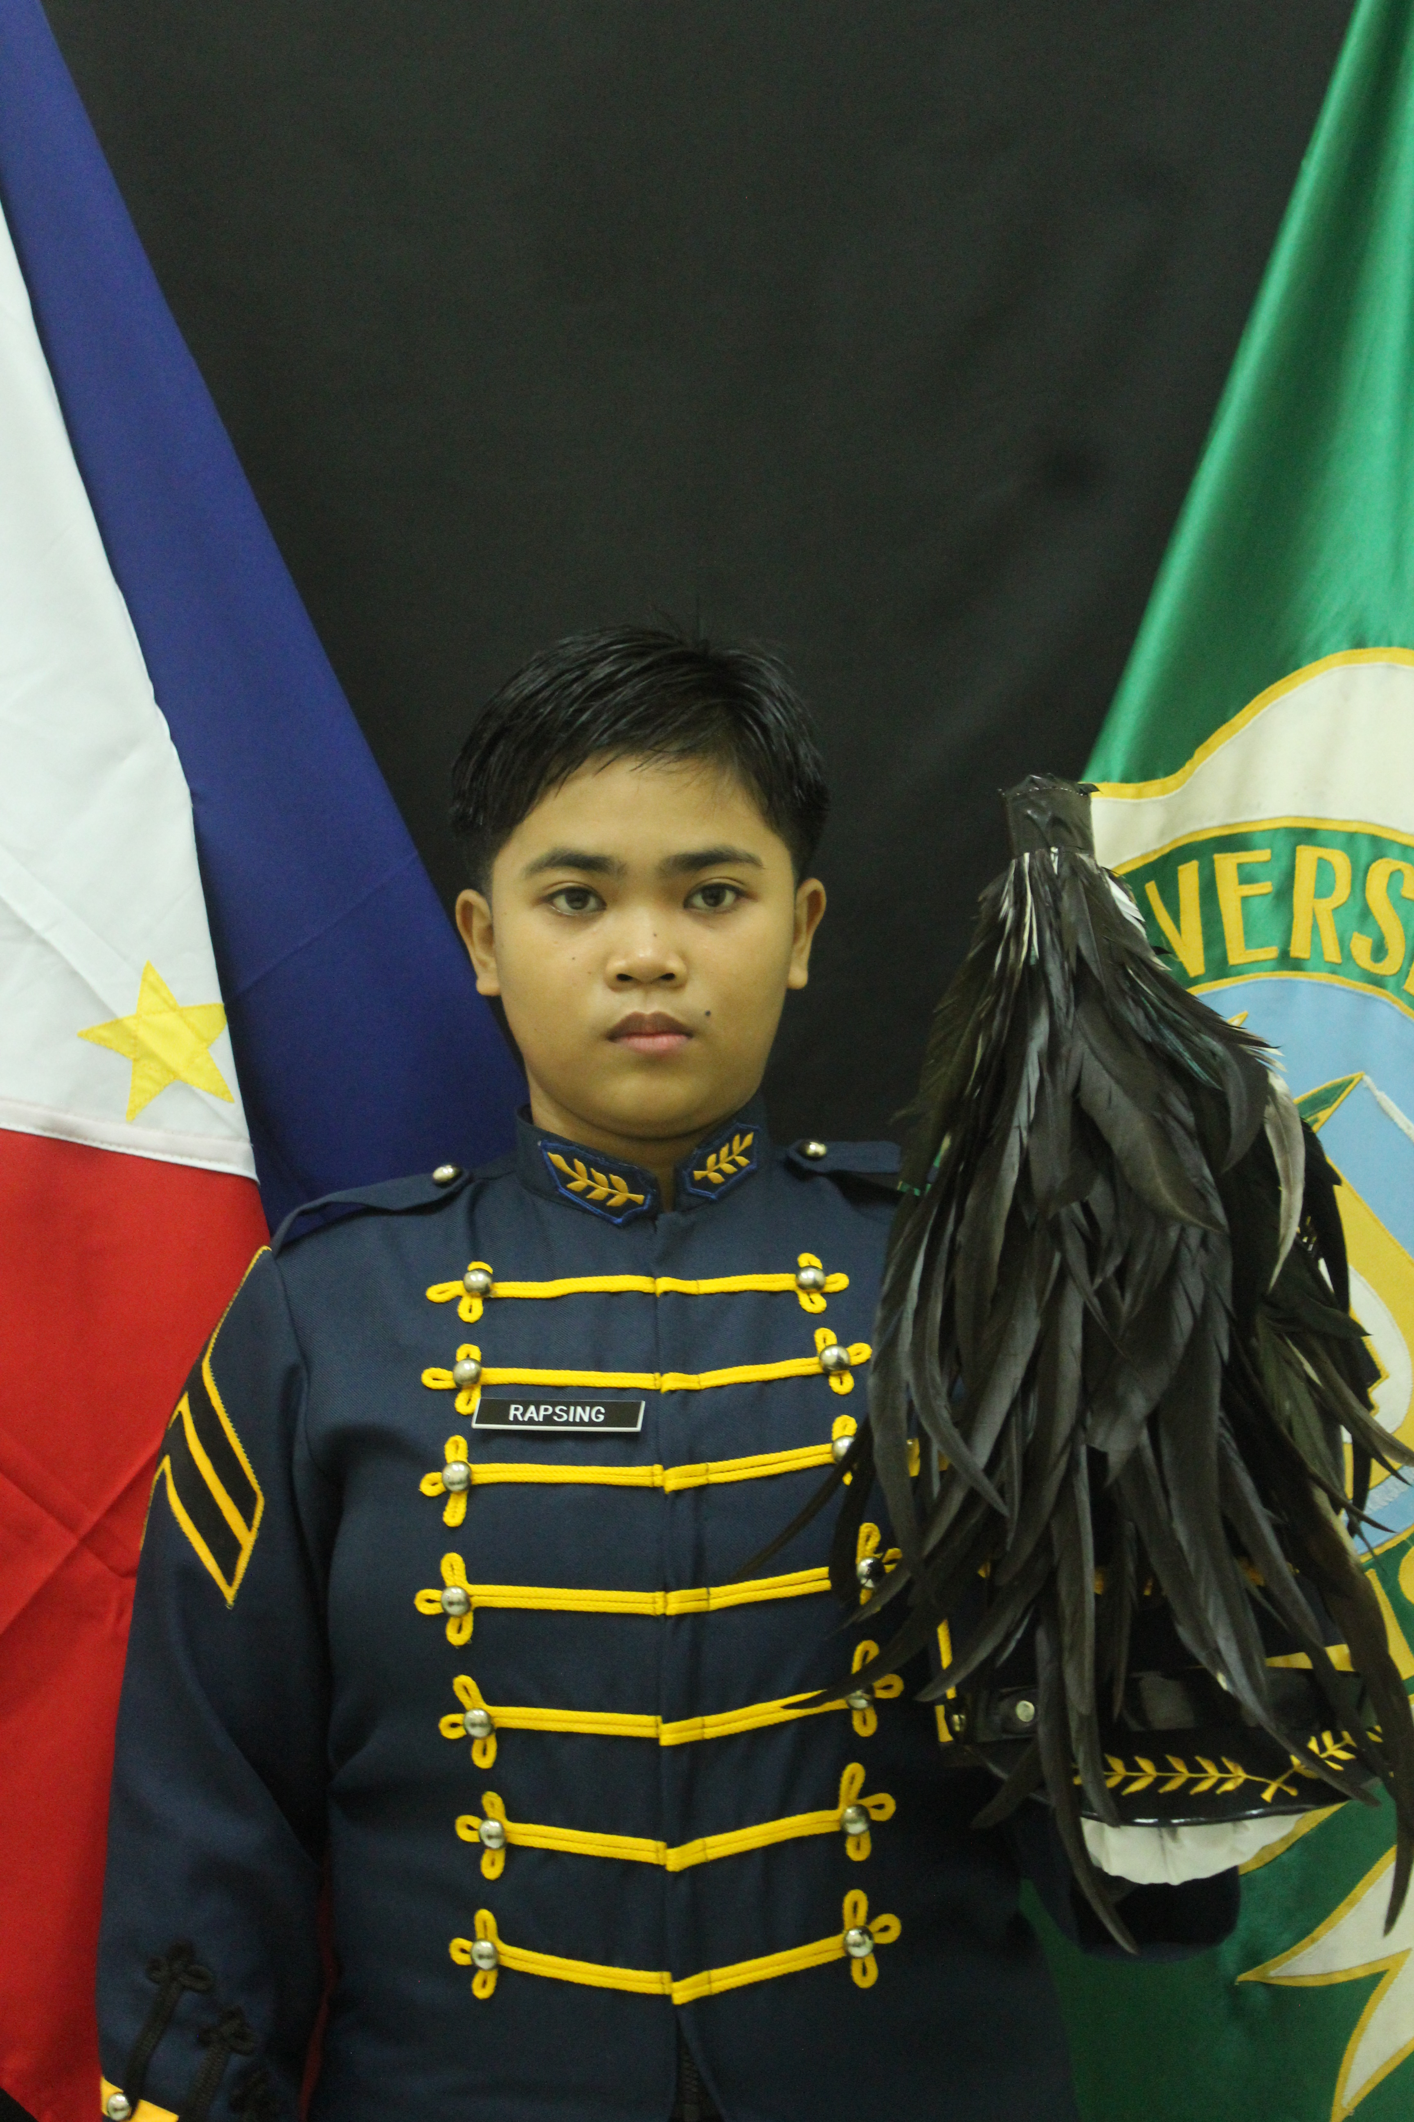
C/CPT GLOIZA C RAPSING 1CL
CORPS G-7 (CIVIL MILITARY OPERATIONS)
STUDENT OF: BICOL UNIVERSITY COLLEGE OF SOCIAL SCIENCES AND PHILOSOPHY
TAKING UP: BACHELOR OF ARTS IN POLITICAL SCIENCE
GRADUATE OF:
CADET OFFICER QUALIFYING COURSE BATCH 2021
ROTC SUMMER CAMP TRAINING CL 21-2022
ADVANCE ROTC ACADEMIC PHASE TRAINING (ARAPT) CL 14-2024

Slide 3
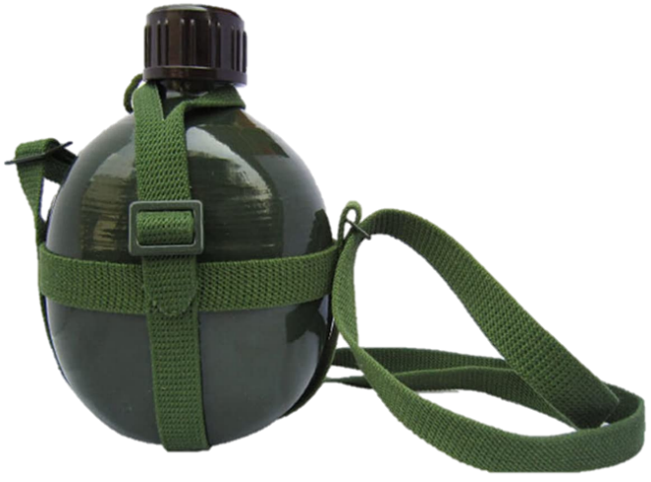
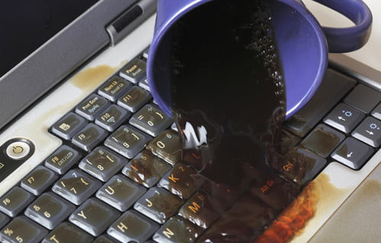
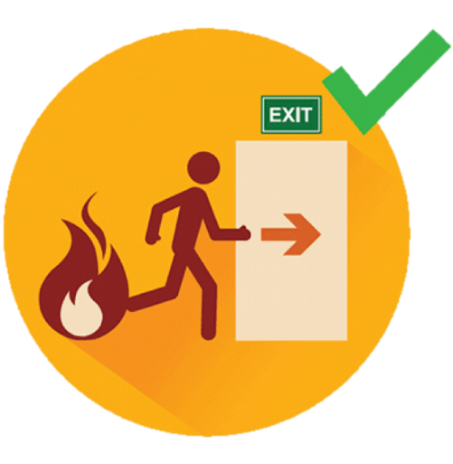
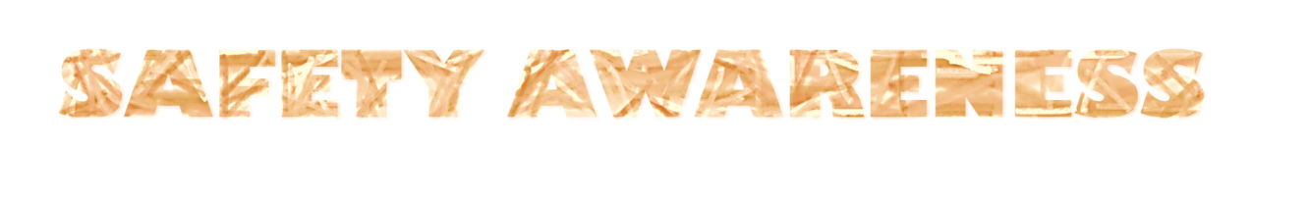
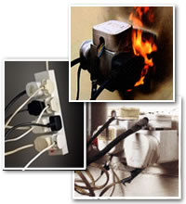


Slide 4
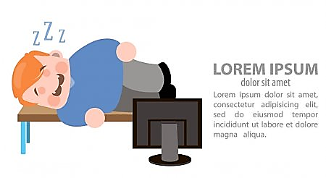
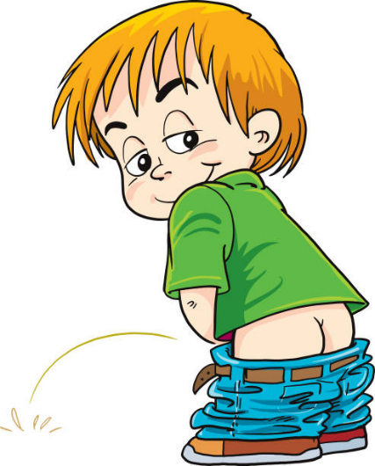

CLASSROOM RULES
Be responsible to keep yourself awake
Finds your way towards the toilet silently when you feel the urge
If there is any question, just write it down on the comment box for those who are online, for the F2F keep your question to yourself and wait to be acknowledged

Slide 5
REFERENCE
FC 1-011 ARMY CORE PHILOSOPHY

Slide 6
FOLLOWERSHIP

Slide 7
TERMINAL LEARNING OBJECTIVE
ACTION:
Discuss and Identify the Followership
CONDITION:
Given in an online and face to face classroom environment, power-point presentation
STANDARD:
The student will be able to understand and know the role of follower, qualities of followers, and how to cultivate effective followers

Slide 8
LEARNING OUTCOME
At the end of this session, the students must be able to understand the importance of Followership.

Slide 9
“Every true leader is a true follower. Every true follower is a true leader. You are followed because of the dreams you pursue; you pursue others because of the dreams they follow!” -Israelmore Ayivor, Leaders' Watchwords-

Slide 10
SCOPE OF PRESENTATION
THE ROLE OF FOLLOWER
QUALITIES OF FOLLOWER
CULTIVATING EFFECTIVE FOLLOWER

Slide 11
THE ROLE OF FOLLOWER
Followership dominates our lives and organizations, but not our thinking, because our preoccupation with leadership keeps us from considering the nature and the importance of the follower. Effective followers differ in their motivations for following and in their perceptions of the role.

Slide 12
THE ROLE OF FOLLOWER
Some choose followership as their primary role at work and serve as team players who take satisfaction in helping to further a cause, an idea, a product, a service, or more rarely, a person. Others are leaders in some situations but choose the follower role in a particular context. Both these groups view the role of follower as legitimate, inherently valuable, even virtuous.

Slide 13
QUALITIES OF FOLLOWERS
Effective followers share a number of essential qualities:
SSS
They manage themselves well.
They are committed to the organization and to a purpose; principle, or person outside themselves.
They build their competence and focus their efforts for maximum impact.
They are courageous, honest, and credible.

Slide 14
QUALITIES OF FOLLOWERS
Self-Management.
SS
The key to being an effective follower is the ability to think for oneself to exercise control and independence and to work without close supervision. Good followers are people to whom a leader can safely delegate responsibility, people who anticipate needs at their own level of competence and authority.

Slide 15
QUALITIES OF FOLLOWERS
Effective followers see themselves except in terms of line responsibility as the equals of the leaders they follow. Ineffective followers, on the other hand, buy into the hierarchy, seeing themselves as subservient; vacillate between despair over their seeming powerlessness and attempts to manipulate leaders for their own purposes.

Slide 16
QUALITIES OF FOLLOWERS
Self-managed followers give their organizations a significant cost advantage because they eliminate much of the need for elaborate supervisory control systems that, in any case, often lower morale.
Self-managed followers give their organizations a significant cost advantage because they eliminate much of the need for elaborate supervisory control systems that, in any case, often lower morale.

Slide 17
QUALITIES OF FOLLOWERS
2. They are committed to the organization and to a purpose; principle, or person outside themselves.
s
Effective followers are committed to something a cause, a product, an organization, an idea in addition to the care of their own lives and careers. Followers who not consistent with the goals of their companies, organization or group can produce destructive results.

Slide 18
QUALITIES OF FOLLOWERS
Leaders having such followers can even lose control of their organizations.
Effective followers temper their loyalties to satisfy organizational needs or they find new organizations. Effective leaders know how to channel the energies of strong commitment in ways that will satisfy corporate goals as well as a follower's personal needs.

Slide 19
QUALITIES OF FOLLOWERS
3. They build their competence and focus their efforts for maximum impact.
ssaaa
Effective followers master skills that will be useful to their organizations. They generally hold higher performance standards than the work environment requires, and continuing education is second nature to them, a staple in their professional development. Good followers see coworkers as colleagues rather than competitors.

Slide 20
QUALITIES OF FOLLOWERS
4. They are courageous, honest, and credible.
ss
Effective followers are credible, honest, and courageous. They establish themselves as independent, critical thinkers whose knowledge and judgment can be trusted. They give credit where credit is due, admitting mistakes and sharing successes. They form their own views and ethical standards and stand up for what they believe in.

Slide 21
Cultivating Effective Followers.
222
Effective followers are, confusingly enough, pretty much the same qualities found in some effective leaders. If a person has initiative, self control, commitment, talent, honesty, credibility, and courage, we say, "Here is a leader!" Followership is a prerequisite for organizational success. Your organization can take four steps to cultivate effective followers in your workforce.

Slide 22
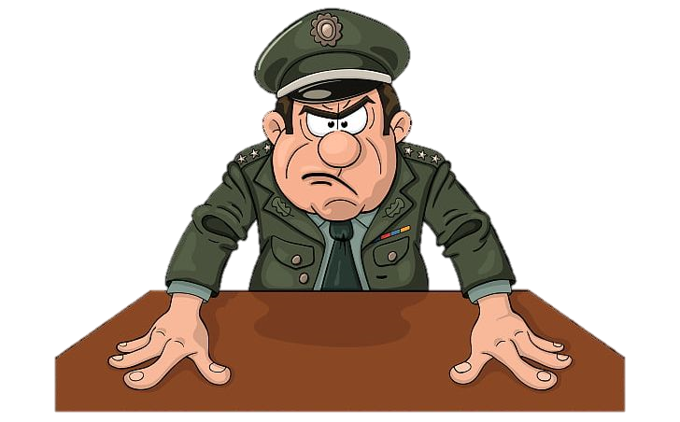
Any Question?

Slide 23


